Slide 1
Common Plan Inefficiencies
Tim Layson

Slide 2
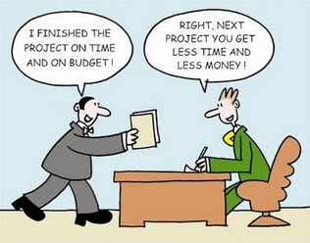
Transportation Cabinet Mission
“To provide a safe, efficient, environmentally sound and fiscally responsible transportation system that delivers economic opportunity and enhances the quality of life in Kentucky.”

Slide 3
Stabilizing Subgrade
Chemical Stabilization
Lime
Cement
Rock Roadbed

Slide 4
Stabilizing Subgrade
Value Engineering Change Orders
Available Durable Rock
Combination
Borrow Area

Slide 5
Bid Items

Slide 6
Bid Items
Incidental Work
Appropriate Units
Items Lacking Description

Slide 7
Bid Items
“Token” Quantities
Significant Variation of Work
Unknown Conditions

Slide 8
Utility Involvement
Early Involvement Critical
Continual Involvement

Slide 9
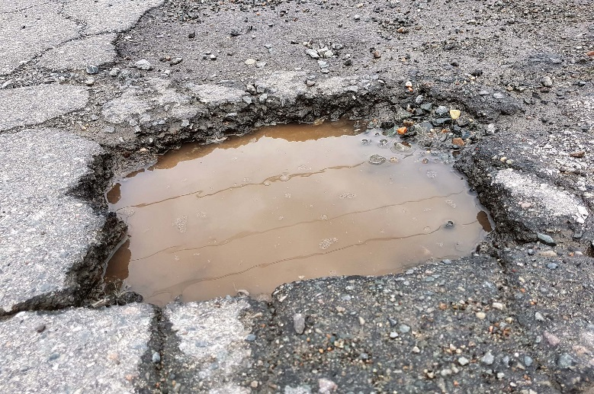
Pavement Removal

Slide 10
Pavement Removal
Should be limited
Most often results in additional removal
Can create additional problems
Provisions for unsuitable subgrade (High Strength Type V Fabric and Stone)

Slide 11
Maintenance of Traffic

Slide 12
Maintenance of Traffic
Contractor Efficiencies
Motorist Inconvenience
Construction Cost
User Cost

Slide 13
Maintenance of Traffic
Overall Project Time
Road Closures
Phasing Impacts

Slide 14
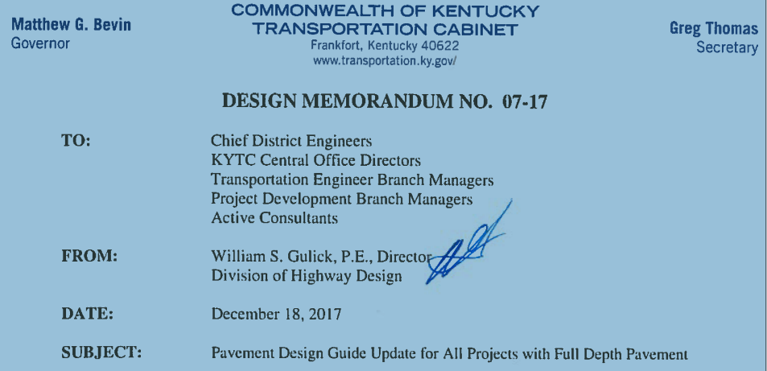
Pavement Thickness
Structural Number to Mechanistic Empirical Design
Reduced Asphalt Pavement Thickness

Slide 15
Pavement Thickness
Core Summary Table

Slide 16
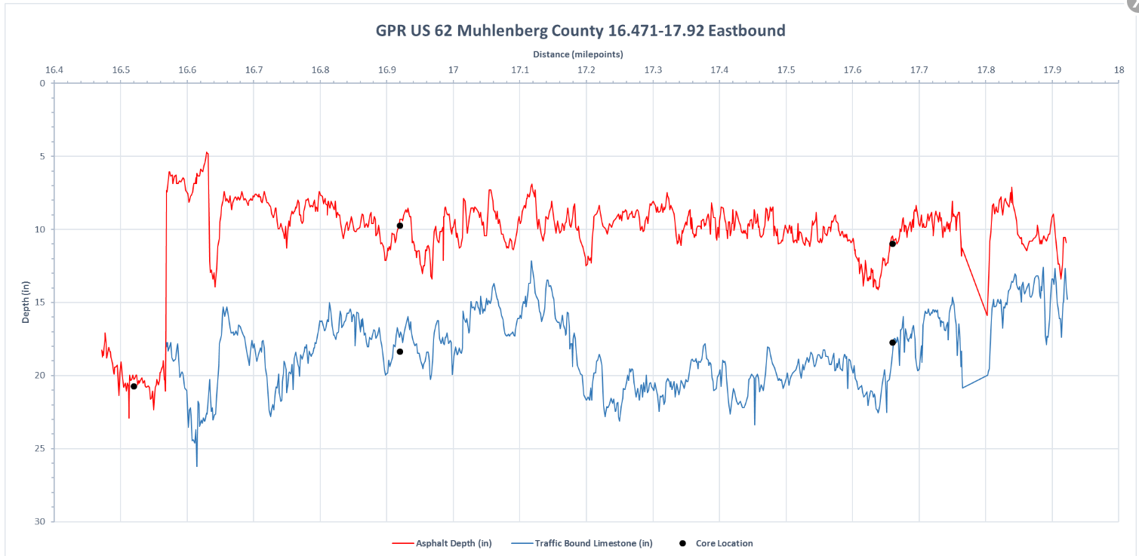
Pavement Thickness
Ground Penetrating Radar

Slide 17
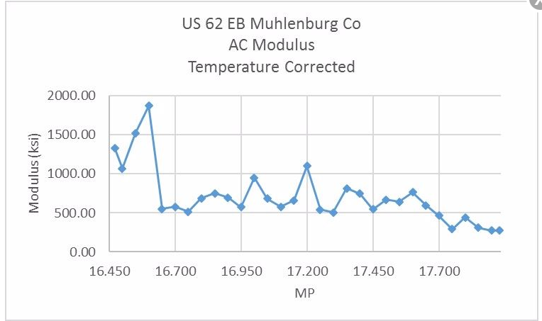
Pavement Thickness
AC Modulus

Slide 18
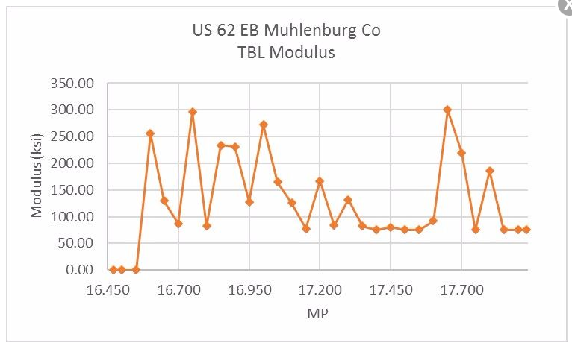
Pavement Thickness
Traffic Bound Limestone Modulus

Slide 19
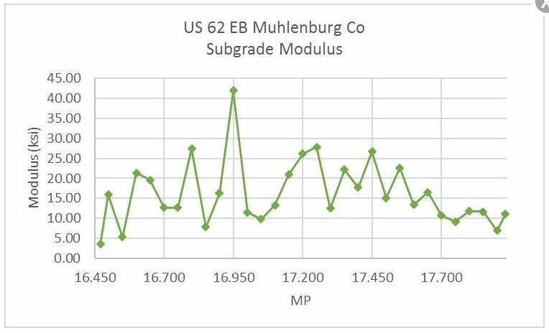
Pavement Thickness
Subgrade Modulus

Slide 20
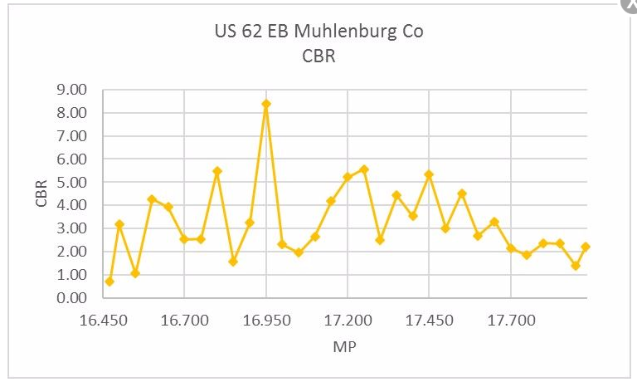
Pavement Thickness
CBR

Slide 21
Pavement Thickness
Potential Savings?
$800,000
Cost for the Forensic Analysis
$18,000

Slide 22
Pavement Thickness
Conclusion
Joseph.Tucker@ky.gov
Pavement Design TEBM

Slide 23
Spline Grades
- a grade line mathematically determined as a function of the existing grade

Slide 24
Spline Grades

Slide 25
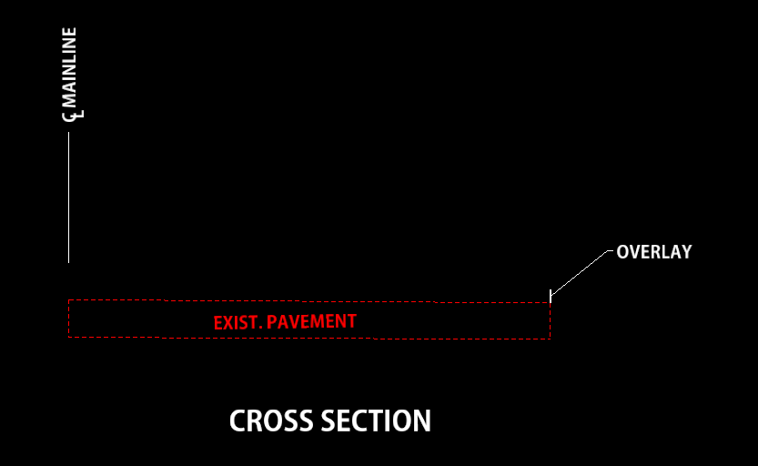
Spline Grades

Slide 26
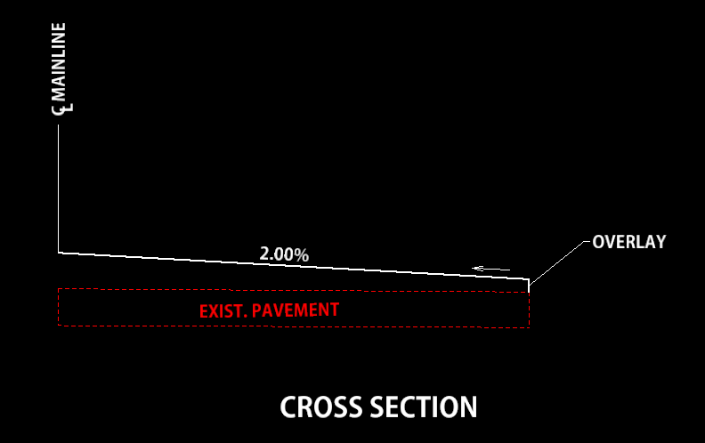
Spline Grades

Slide 27
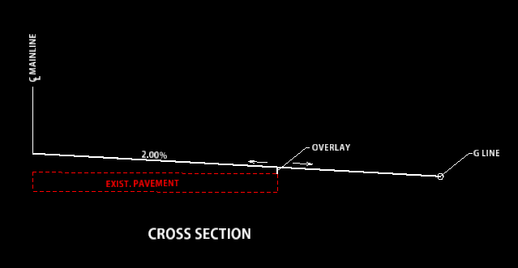
Spline Grades

Slide 28
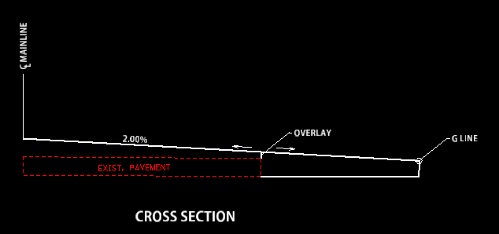
Spline Grades

Slide 29
Questions?

Slide 31
“ Anyone who has never made a mistake has never tried anything new ” – Albert Einstein

